Slide 1
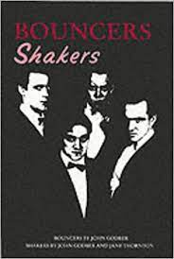
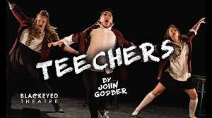
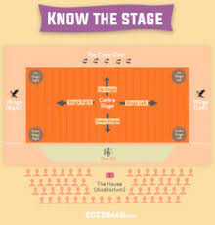
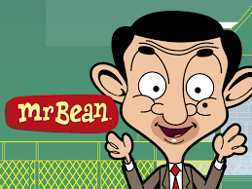
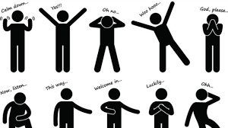
Drama
Responding to a Brief
January – material is released.
Developing Skills and Techniques in the Performing Arts
Component 3
Component 2 cont.
Workshops
YEAR
Themes and Issues
11
Component 2
Costumes, lighting, sound and set
Exploring the Performing Arts
Examine professional practitioners’ performance work
Explore the interrelationships between constituent features of existing performance material
Workshops
YEAR
Component 1
10
Ruth Ellis –
Devising
Performing & Recording
Performing as an ensemble
Frantic Assembly
John Godber
Shakespearean dialogue
Stage combat
Rhythmic movement
Staging
Verbatim Theatre
YEAR
Romeo and Juliet
Musical theatre
Naturalism
9
Rhymical movement
Soundscapes
Transition
Script work
Dystopia
Improvisation
Chair duets
Devising
Caricatures
Accents
Characterisation
YEAR
Commedia
Dell’arte
Pantomime
8
Physical Theatre
YEAR
Links to Musical theatre
Choreography
8 & 9
Stage directions
Scripted performance
Performing simple scripts
Performing as an ensemble
Introduction to vocal skills and techniques
Scripts and Stage
Darkwood
Manor
Working collaboratively
Performing & Recording
Role on the Wall
Rehearsing
Evaluating
Communication
Characterisation
YEAR
Mime and silent movies
Developing Skills
7
Body language and movement
Blocking and Levels
Devising
Facial expression

